Slide 1
Session Facilitators:
Cathy Kenny-Wilkerson
Audrey Spialek
MyEnergy End User Training
Regional Clean Energy Hubs & Hubs Team

Slide 2
Overview and General Navigation
2

Slide 3
General navigation
How to Register/Login to MyEnergy
How to Modify My Profile
How to Access the Learning Center
How to Request Support in My Energy
How to Search for a Hub
3

Slide 4
How to Register/Login to MyEnergy
4

Slide 5
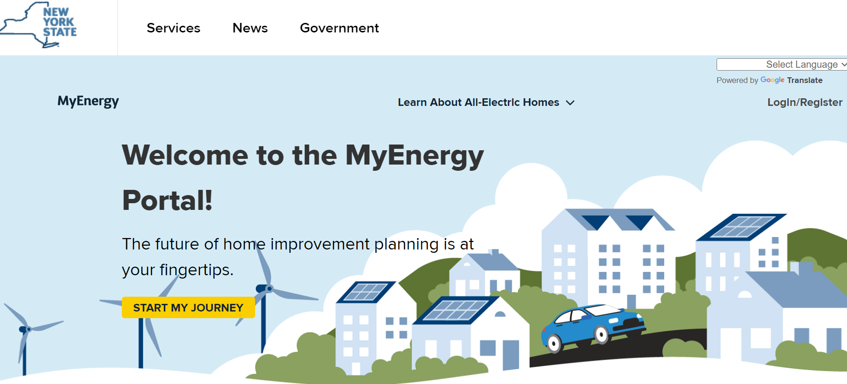
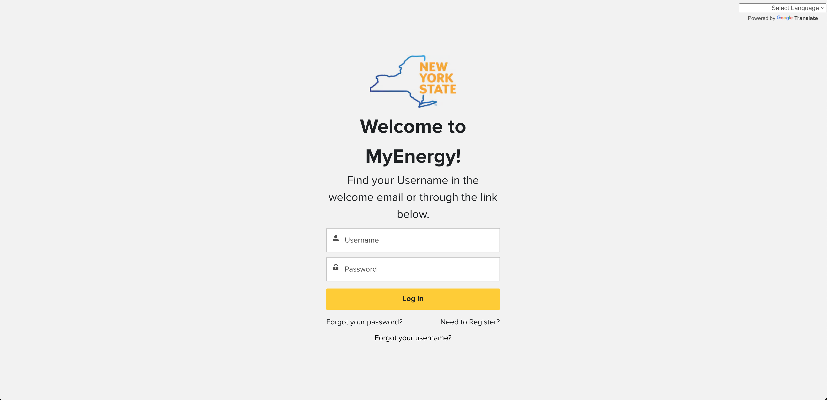
How to Register to MyEnergy as a First Time Resident User?
General navigation
Step 1. Navigate to MyEnergy in Your Browser and Select Login/Register
MyEnergy Portal Link
Plan.MyEnergy.ny.gov
Step 2. Click Need to Register?

Slide 6
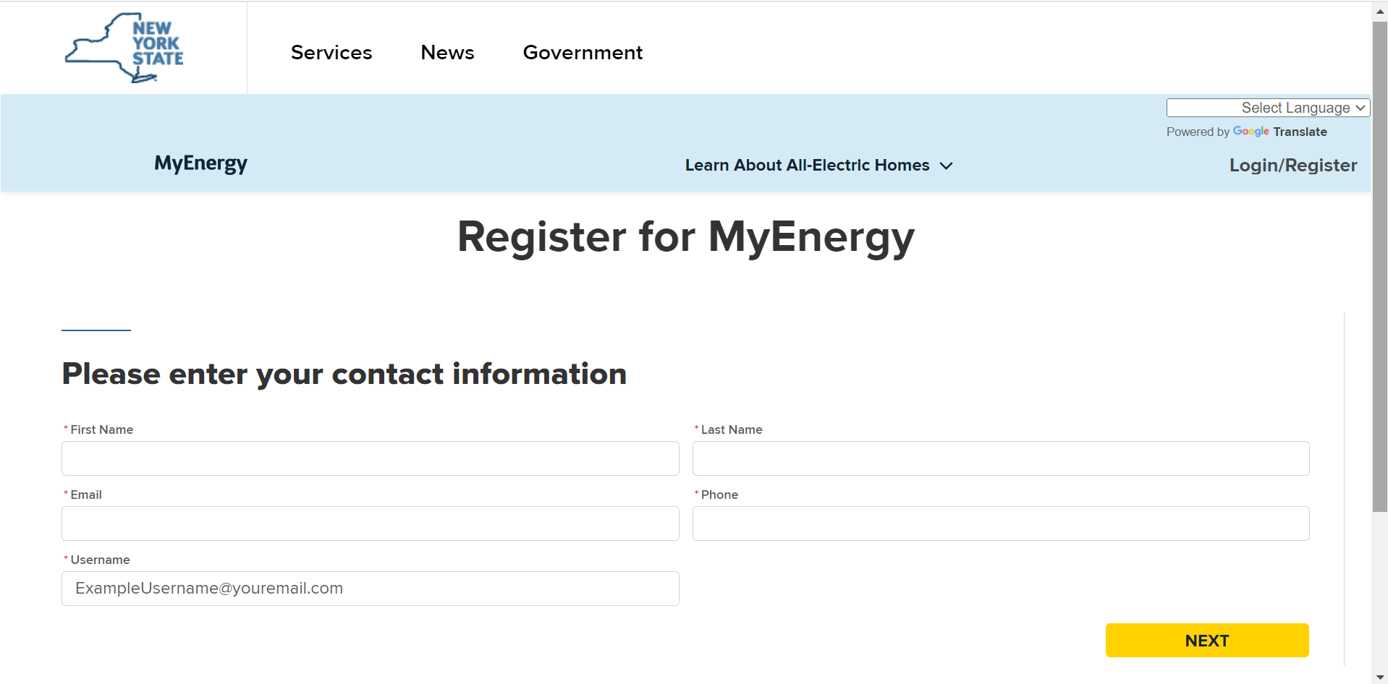
How to Register to MyEnergy as a First Time User?
General navigation
Step 3. Enter you Contact Information and Click Next
Contact Information Needed for Registration:
The following information will be needed to register for MyEnergy
First Name
Last Name
Email
Phone
Username (ExampleUsername@youremail.com)

Slide 7
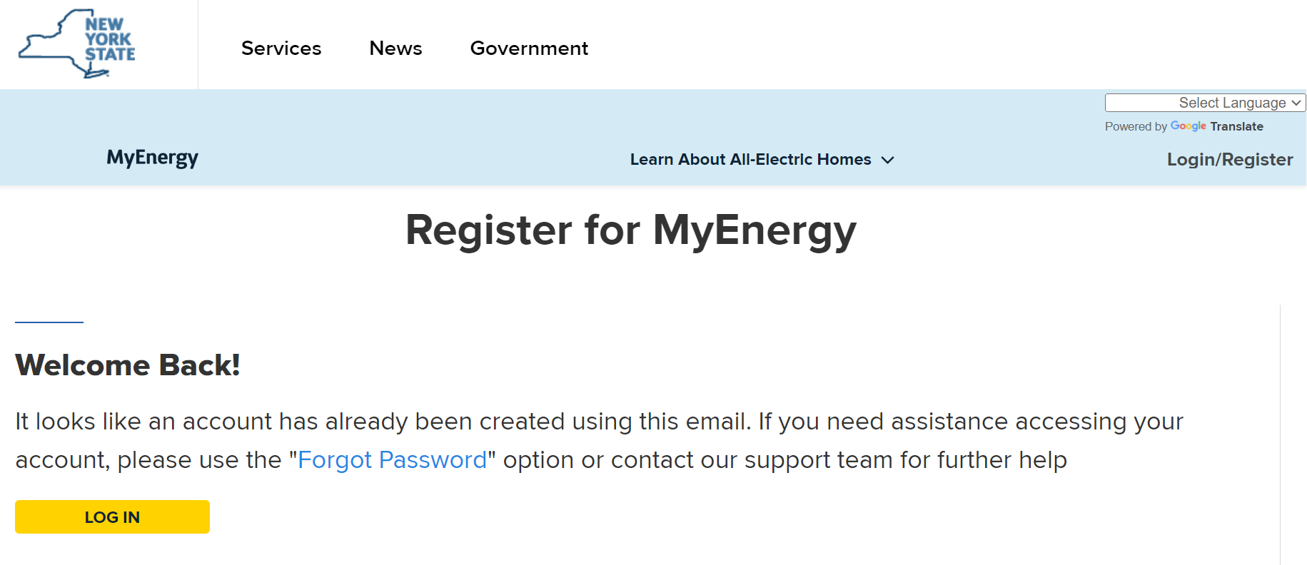
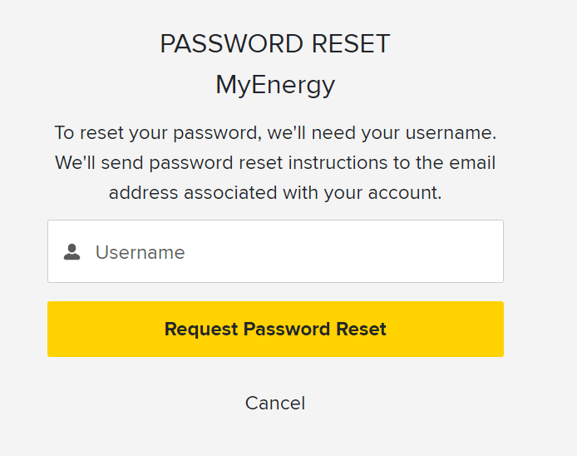
How to Register to MyEnergy as a User with Existing Login Credentials?
General navigation
Step 4. Users with NYSERDA login credentials will use the same credentials, if you need to reset your password Click Forgot Password
Step 5. Enter Username and Click Request Password Reset
Requesting Password Reset:
You will receive password reset instructions to the email address associated with your NYSERDA portal account

Slide 8
How to Modify my Profile

Slide 9
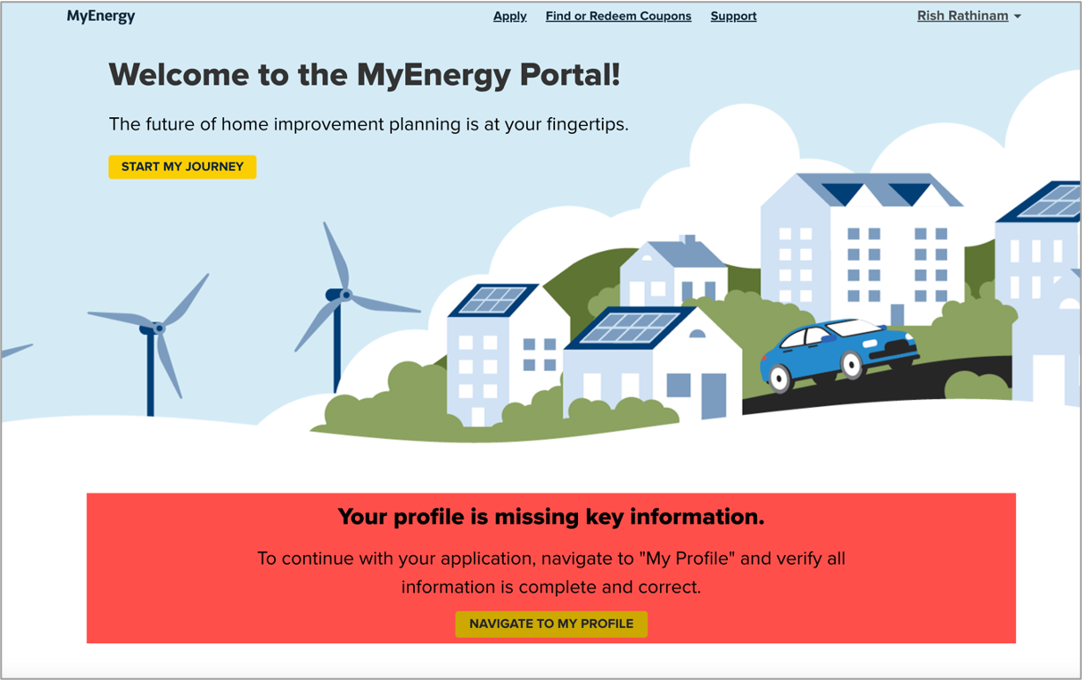
How to Modify my Profile?
General navigation
yany
Name
Step 0. If missing key information, an Error widget will appear on your home page

Slide 10
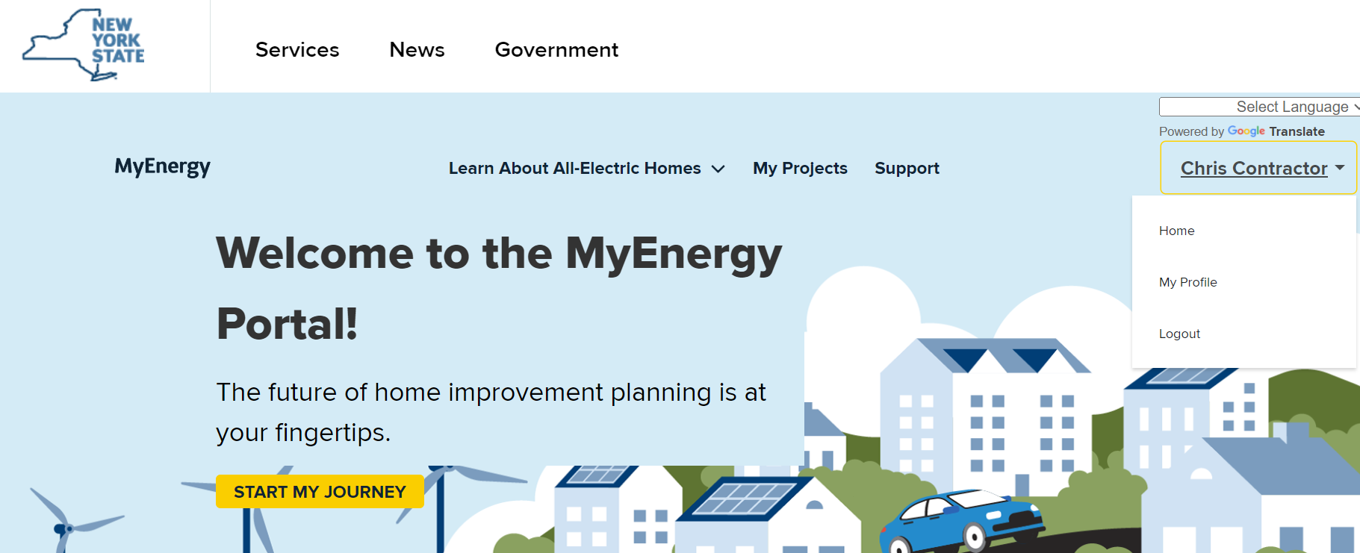
How to Modify my Profile?
General navigation
Step 1. Once logged in, Select the Drop-Down arrow next to Click My Profile

Slide 11
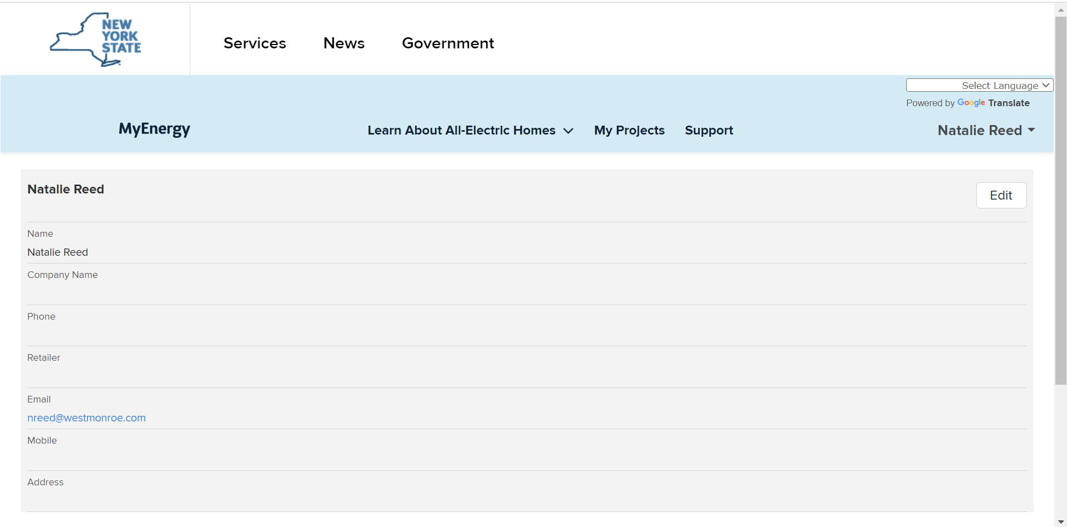
How to Modify my Profile?
General navigation
Step 2. Click Edit
Name
Name

Slide 12
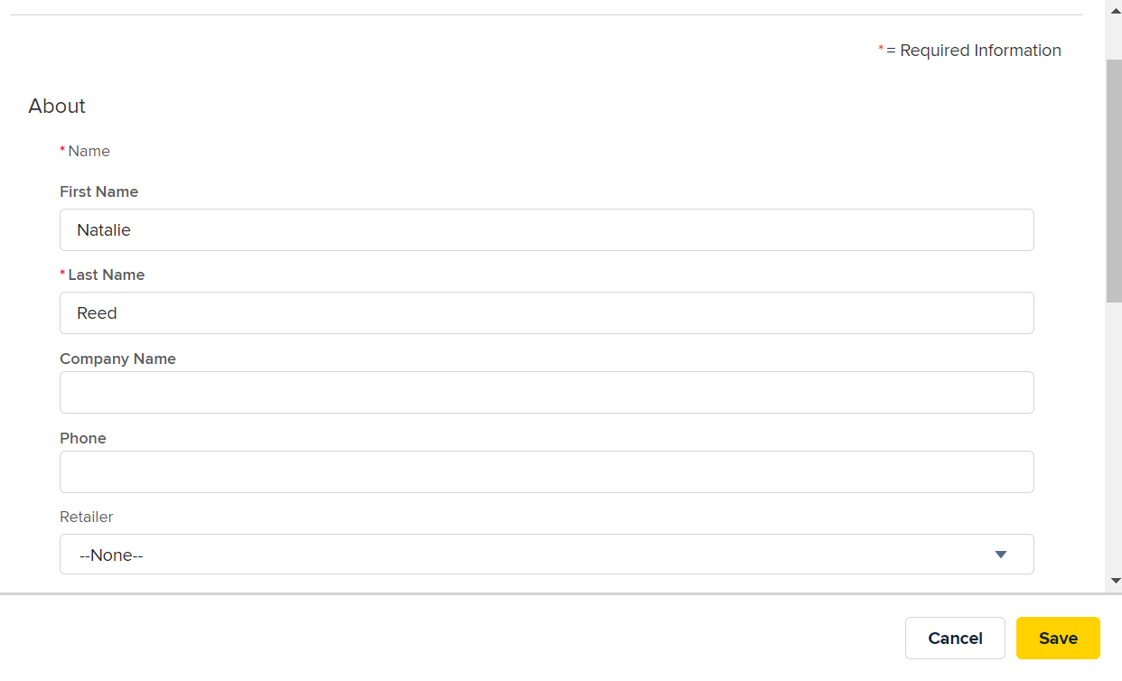
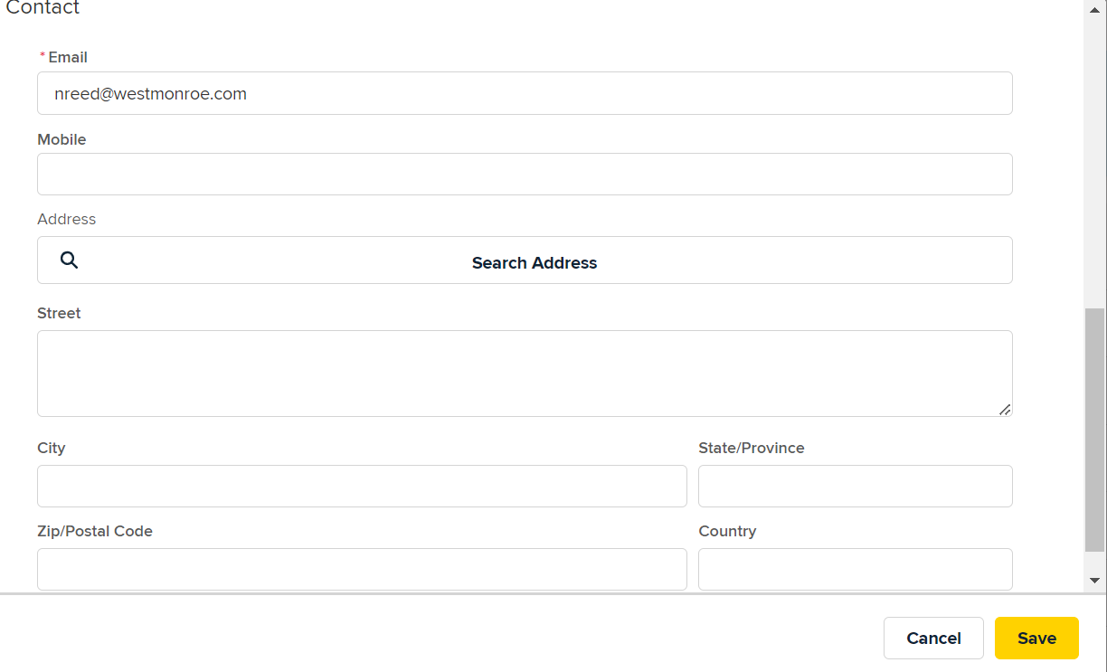
How to Modify my Profile?
General navigation
Step 3. Enter About/Contact Information and Click Save
Required Profile Information:
First Name, Last Name, Email, Phone, and
Mailing Address

Slide 13
How to Access the Learning Center

Slide 14
How to Access the Learning Center?
General navigation
Step 1. Open MyEnergy Home Page and Click Learn About All-Electric Homes
Leaning Center Link
MyEnergy.ny.gov

Slide 15
How to Request Support

Slide 16
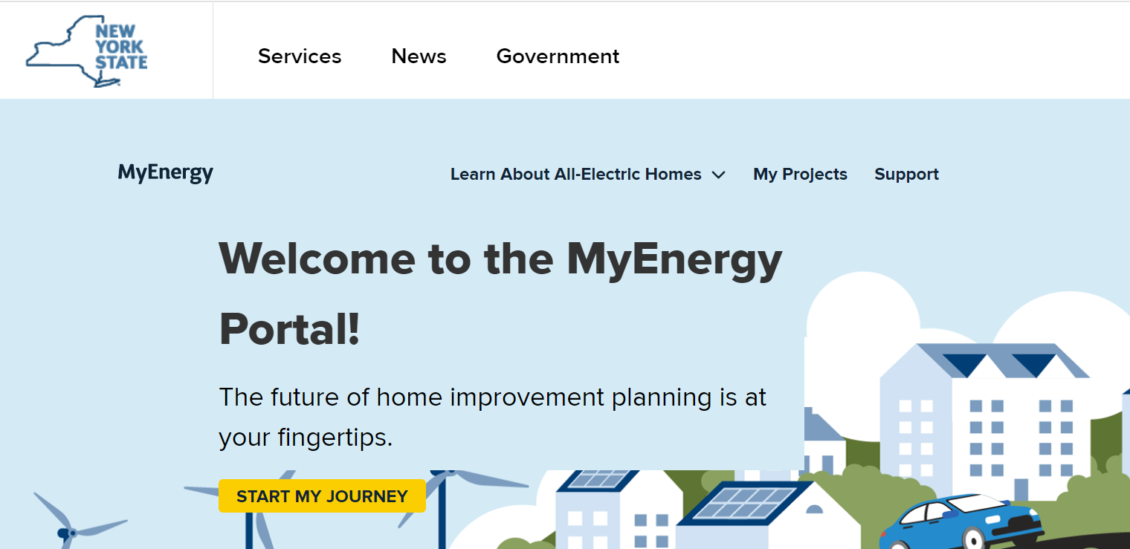
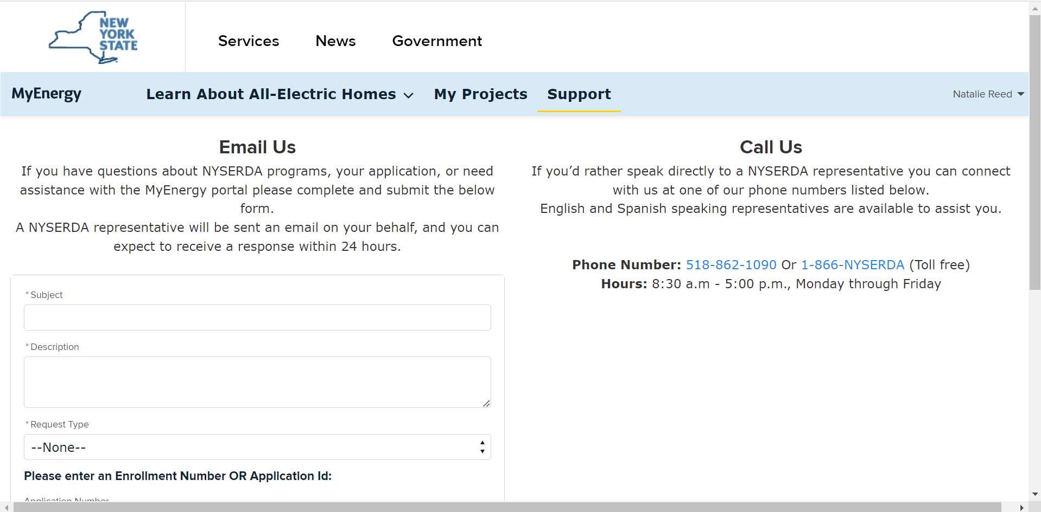
How do I Request Support?
General navigation
Step 1: Navigate to MyEnergy Home Page and select Support
Step 2: Request Support through Email or Call
Name

Slide 17
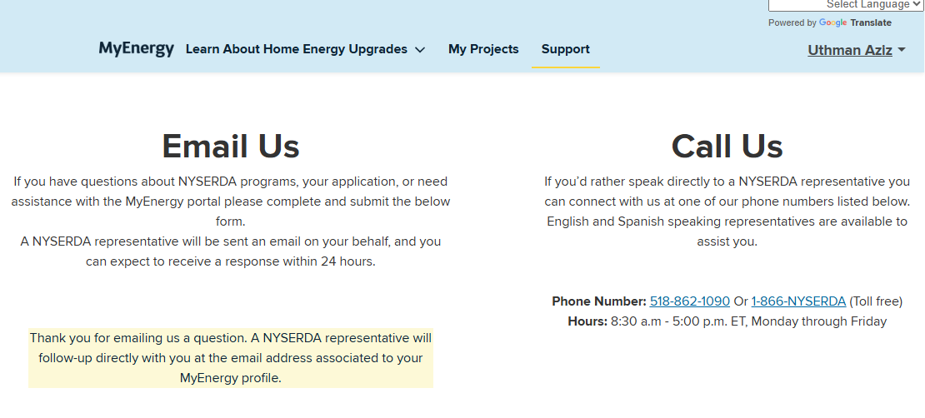
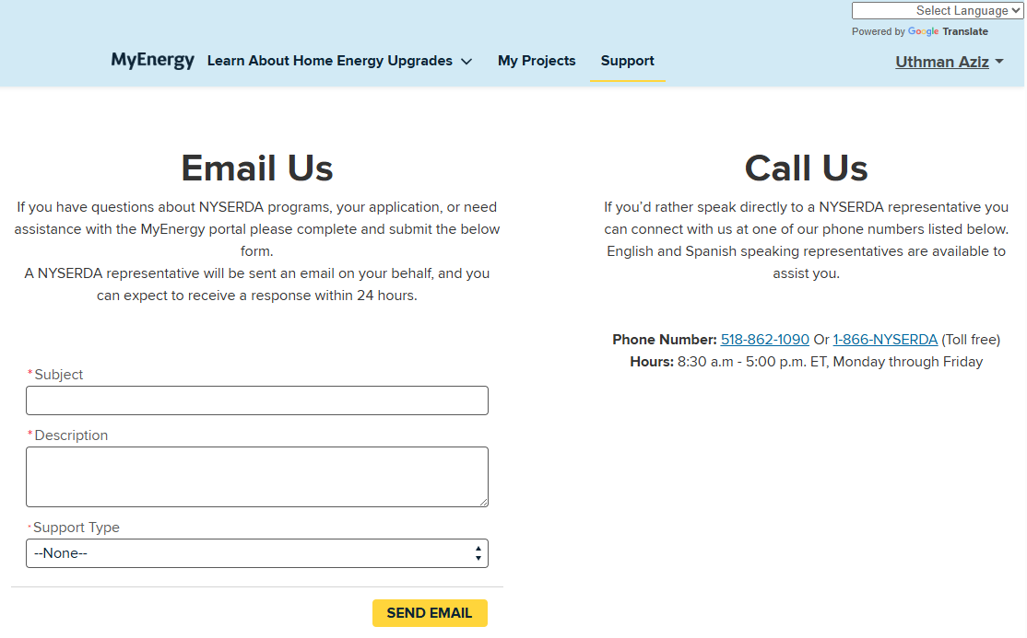
Requesting Support via the Email Us form
General Navigation
Update subject with high level description of your inquiry followed by supporting details to assist in mitigation strategy
Application and Enrollment number can be found within the "My Projects" tab

Slide 18
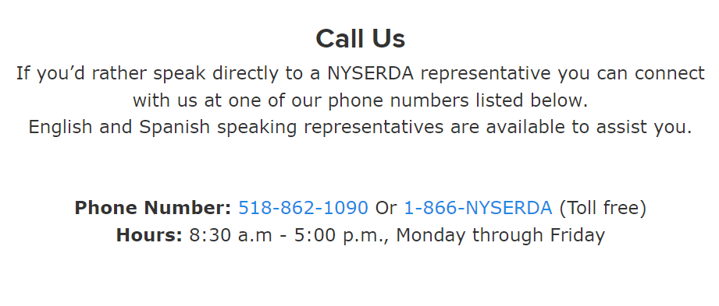
Requesting Support via the Call Us form
General navigation
Your Name
When possible, have your contact information and/or application number on file available to assist the agent in locating your records

Slide 19
Where does my Request for Support go?
General navigation
MyEnergy Support Information:
The routing of each Support Type varies based on the audience submitting questions. The following showcases which questions will be routed to
Application Support -> Routes to TRC
Whole Home Project -> Routes to CLEAResult
Appliance Support -> Routes to TRC
General Process Support -> Routes to TRC
Other -> Routes to TRC (May get reassigned to CLEAResult)
  All Support Types require an Application Number OR Enrollment Number except for "Other"

Slide 20
Application Management
20

Slide 21
Application management
How to Submit an Application
How to View an Application
21

Slide 22
How to Submit an Application
22

Slide 23
Application management
How to Submit an Application
Points to Remember
Be sure to complete each section. If you need more time, you can save your application and return to it at any time.
Make sure the contact person listed on the application is the same person listed on the electric utility bill.
You will need to upload the most recent electric utility bill and required eligibility documents with your application submission. If you don't have them now, you can save your application and return to it when you have the documents available.
'*' Indicates a required field. You must fill out this field to proceed with your application.
Need help?
Call us at: 866-NYSERDA, or email us
EmPower+ Support: info.residential@nyserda.ny.gov
AUP Support: AUP@nyserda.ny.gov
Notes:
Bills and categorical eligibility documents need to be recent.
These help numbers are on every page of the MyEnergy App
You can always save the application and come back to finish it later.

Slide 24
How to Submit an application
How to Submit an Application
The following information will need to be filled out throughout the application process
Applicant Information
Assistance Information
Physical Address Information
House Gross Income Range
Home Improvement Project Type
Eligibility Details
Appliance Information (for AUP)
Your Contact Information
Site Location
Landlord Information
Utility Information
Partner Information
Household Member Information
Categorical or Income and Utility Bill Documentation
eSignature

Slide 25
How to Submit an Application?
Application management
Step 1: Navigate to MyEnergy Home Page and Click Start My Journey
Notes:
You would be login in as a hub. Once you enter the application treat it as its own window and make sure to not click the back button. You can save and click next or previous. Using the MyEnergy portal you can use the back button just not on the application.

Slide 26
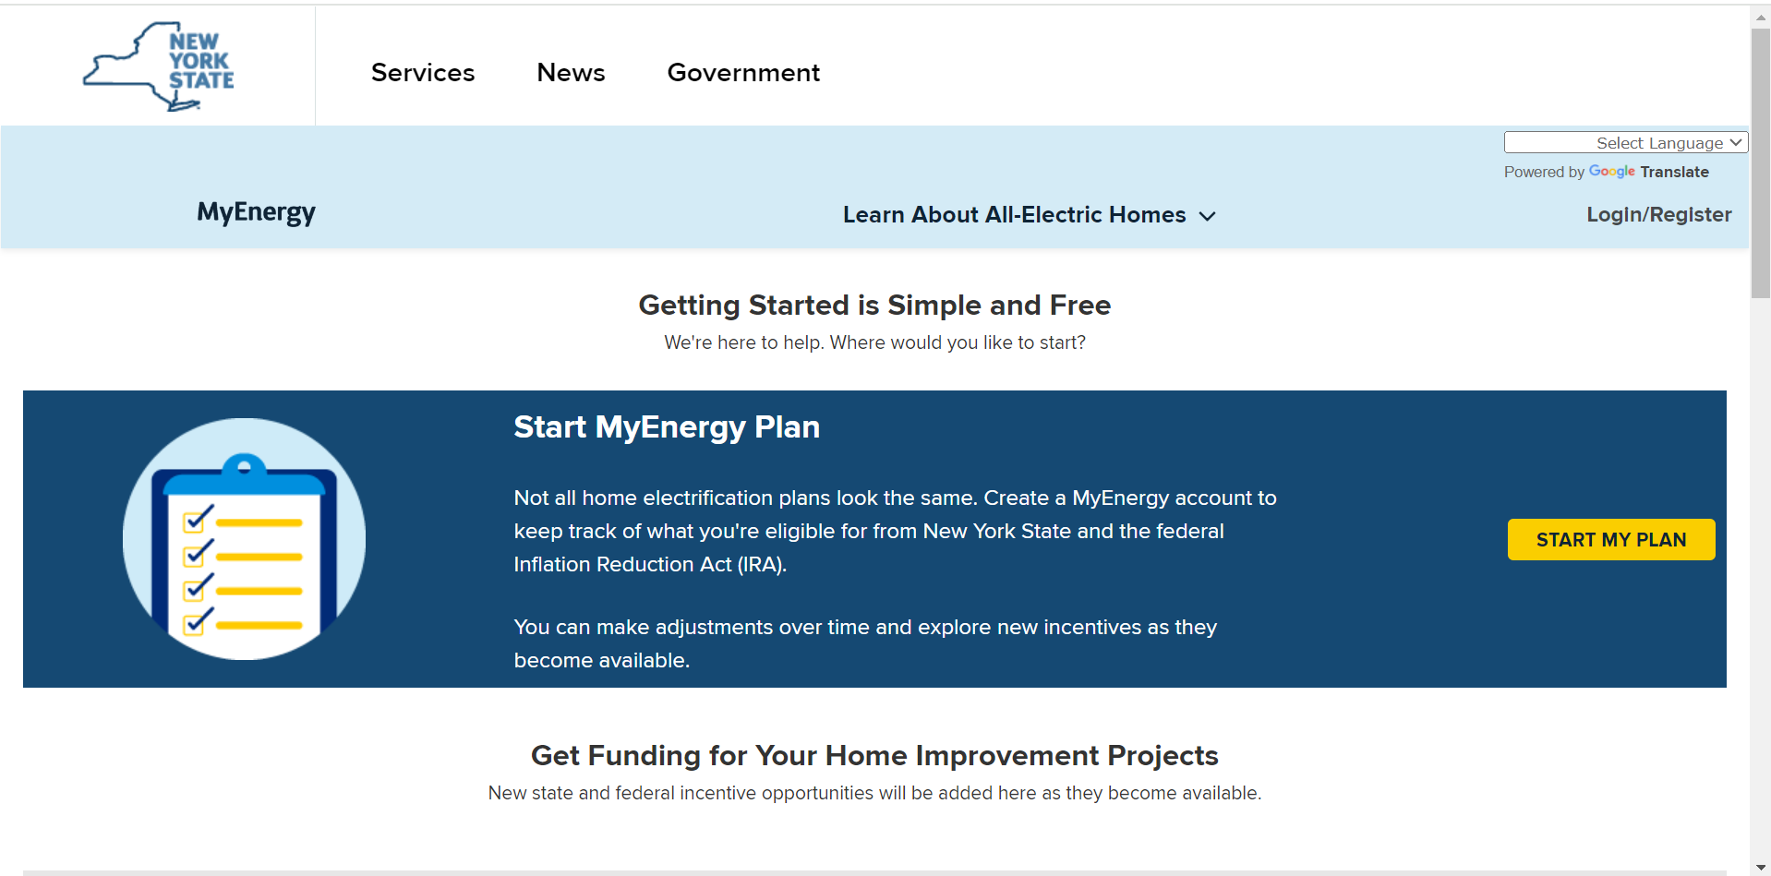
How to Submit an Application?
Application management
Step 2. Click Start My Plan
Projects Currently Available
Weatherization
Heat Pump Dryers
Home Energy Assessment
Application Example:
For this Example, we will be going through the application process for Weatherization
Notes:
We are going to go through the process for weatherization

Slide 27
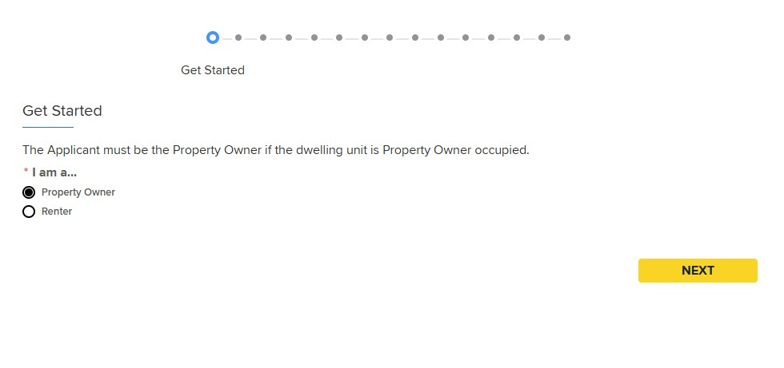
Step 3. Enter Applicant Information, select your role & if applicable, select who you are applying on behalf ofStep 3. Enter Applicant Information, select your role & if applicable, select who you are applying on behalf of
Application management
Application Information:
Submitting an application can be completed by a
    Homeowner
    Renter
    Regional Clean Energy Hub
Hubs can submit an application on behalf of a Homeowner or Renter

Slide 28
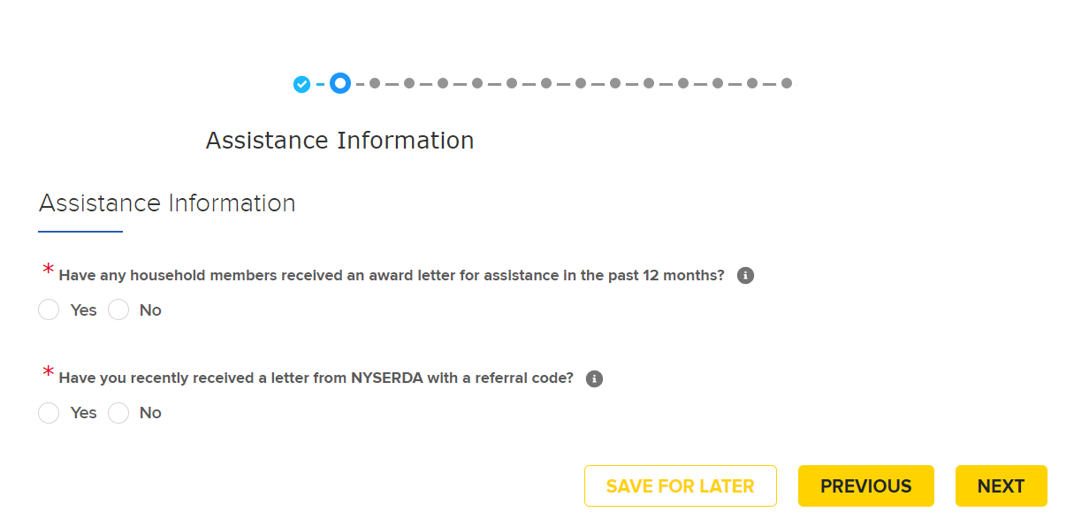
How to Submit an Application?
Application management
Step 4. Enter Assistance Information
Assistance Information:
Question #1: Select 'Yes' if they are receiving or have received any of the following services within the past 12 months: HEAP, SNAP, SSI, TANF, Weatherization Assistance Program (WAP), or Public Assistance
Question #2: If they received a referral letter from NYSERDA, they can find the referral code in the third paragraph of your referral letter (example: NTF-GAS) and provide to you. The code is based on the referral entity but should always be 6 digits.
Notes:
If you select YES you can select which services you received.
If you select yes input the 6 digit referral code.

Slide 29
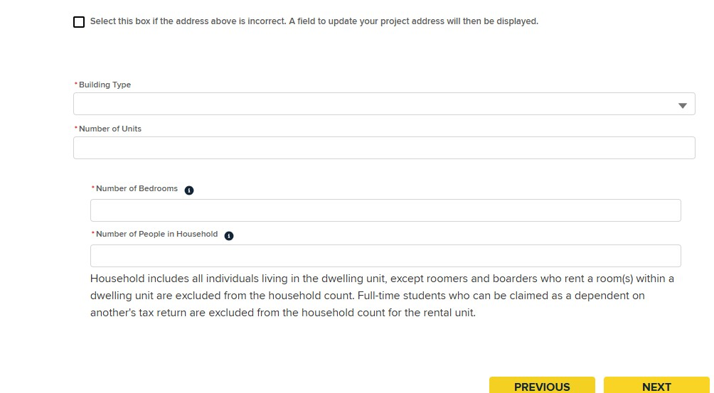
How to Submit an Application?
Application management
Step 5. Enter Physical Address Information and Click Next
Physical Address Information:
Number of People in Household: If the household includes more than 10 people, please enter 10 as the maximum value.

Slide 30
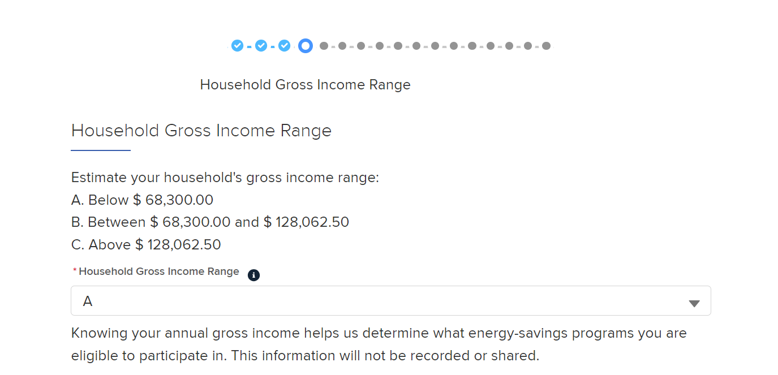
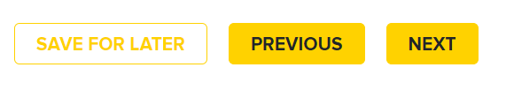
How to Submit an Application?
Application management
Step 6. Select Household Income Range and Click Next
Household Income Range:
Please select a letter that best corresponds to the resident’s estimated gross income range below.
Be sure to include all sources of their income, not only their wage or salary.
Other sources of income include disability, worker's compensation, unemployment, pension, maintenance, annuities, Veteran's benefits, tax forms, and social security
Notes:
This is the question that will drive the customers eligibility. These household income ranges are calculated based off of the site address and number of household members we inputted previously.

Slide 31
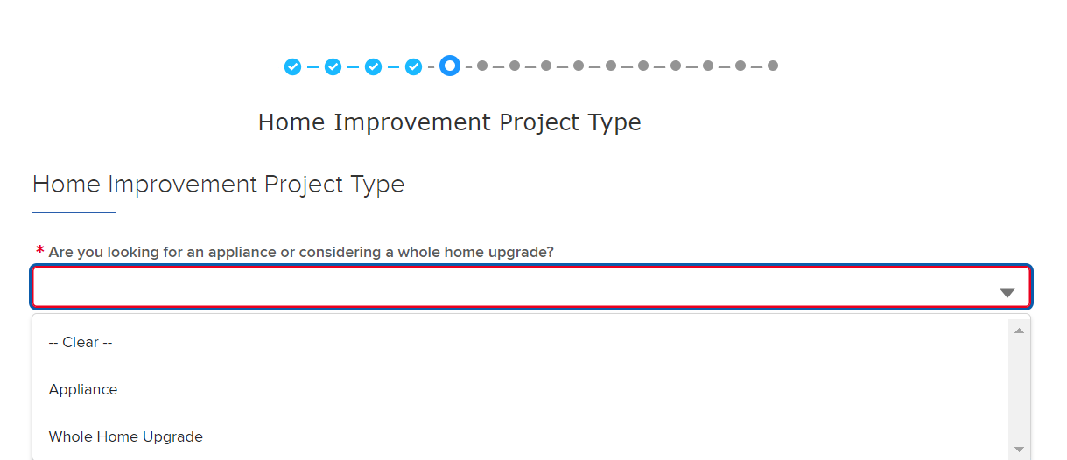
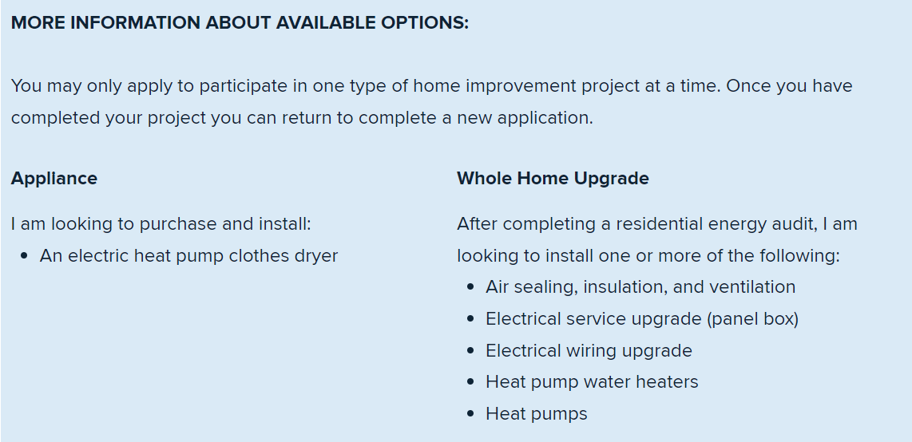
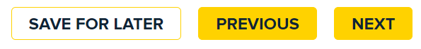
How to Submit an Application?
Application management
Step 7. Select Home Improvement Project Type and Click Next
Available Project Types:
Residents may only participate in one project at a time; therefore, they have the option to select between Appliance or Whole Home Upgrade
Notes:
You can choose either appliance which will route to Appliance upgrade program or whole home which could route to comfort home or Empower +
The blue box would appear at the bottom of the screen to give the contractors more details about which program they are signing up for.

Slide 32
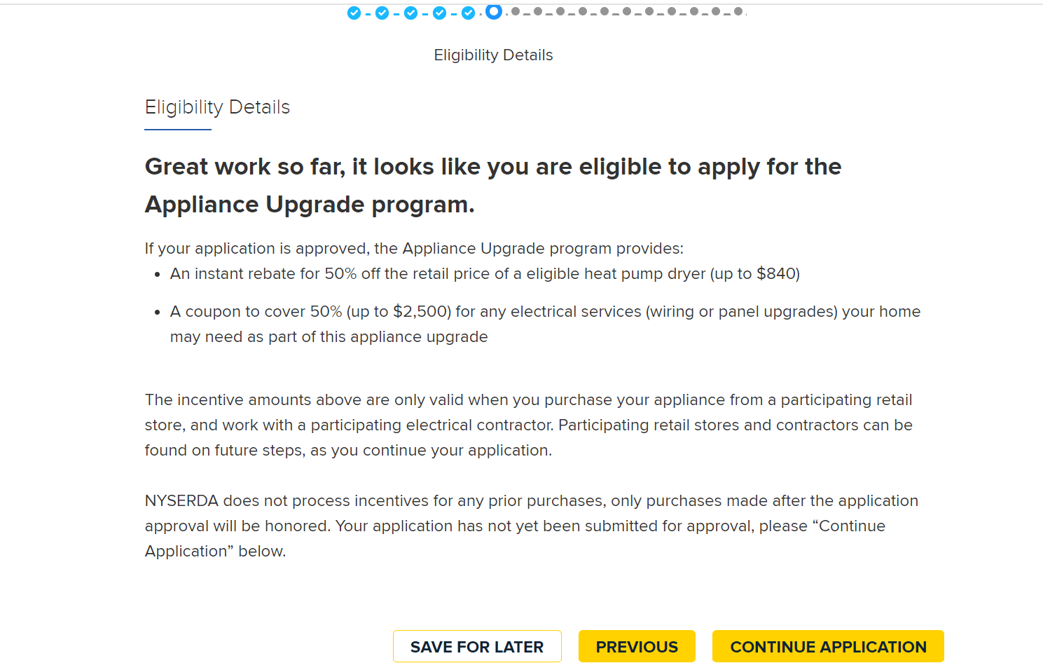
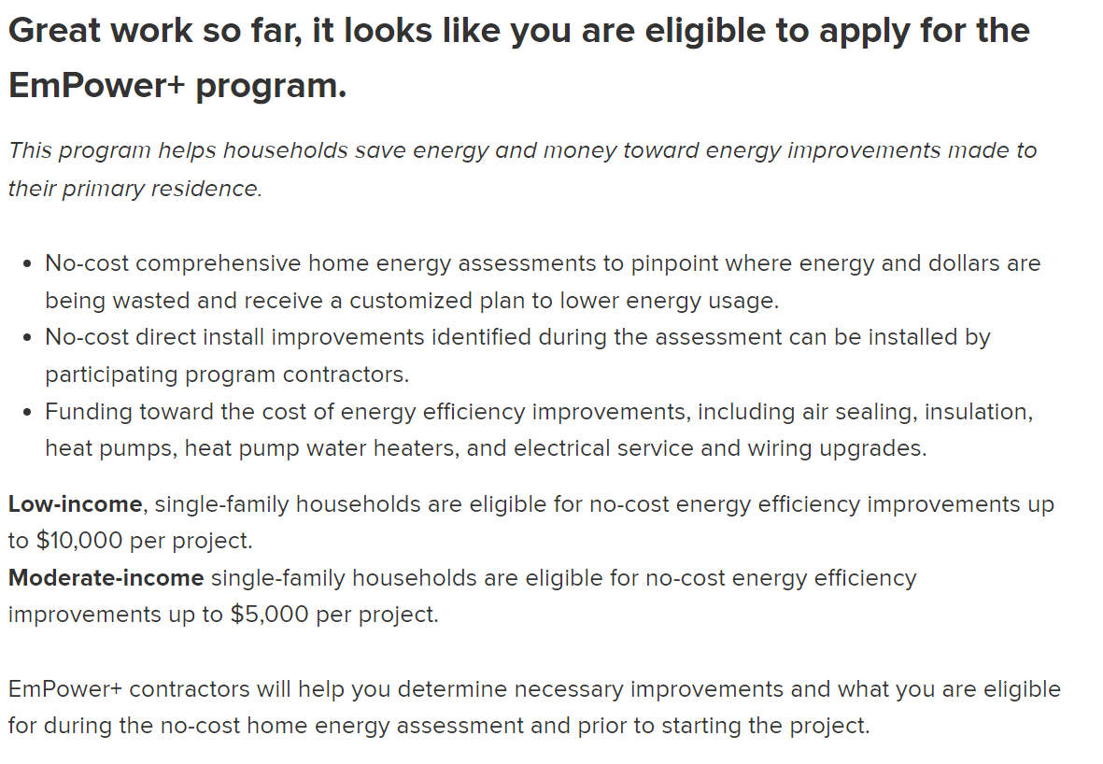
How to Submit an Application?
Application management
Step 8. Review Eligibility Details then Select Continue Application
Income Determination of Eligibility:
Income Determines:
Eligibility to participate in EmPower+
Eligibility to participate in AUP
Eligibility to participate in Comfort Home
Notes:
This is the end of the pre application. This is where you will be able to see what programs you are eligible for.
We can see the congratulations message with program specific details underneath. In this example we are routed to EmPower +
For AUP you will be able to see either 50 % or 100% rebate information.
For Comfort home you will be routed to a button to find a participating contractor.

Slide 33
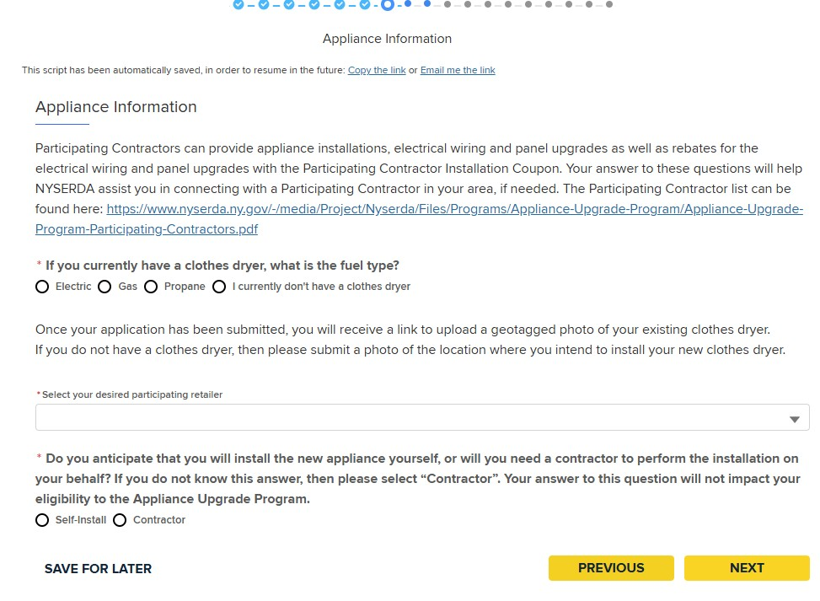
How to Submit an Application?
Application management
Step 9. For Appliance Upgrade Applications, Enter Appliance Information and Click Next
Step 10. Click Next
For AUP, Upload a Photo of the Existing Appliance:
The appliance photo should be clear and visible, showing the entire appliance and its controls

Slide 34
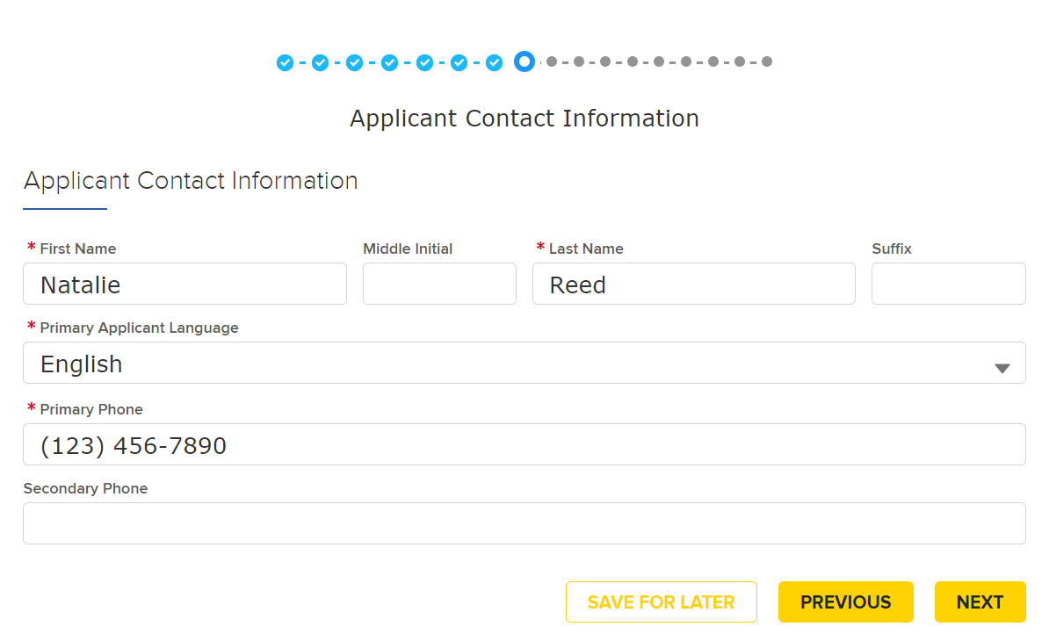
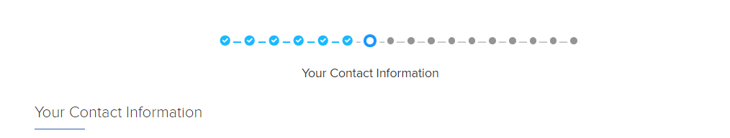
How to Submit an Application?
Application management
Step 10. Enter Your Contact Information and Click Next
Notes:
This is where the you the contractor would add the contact information for the customer who is applying.
.

Slide 35
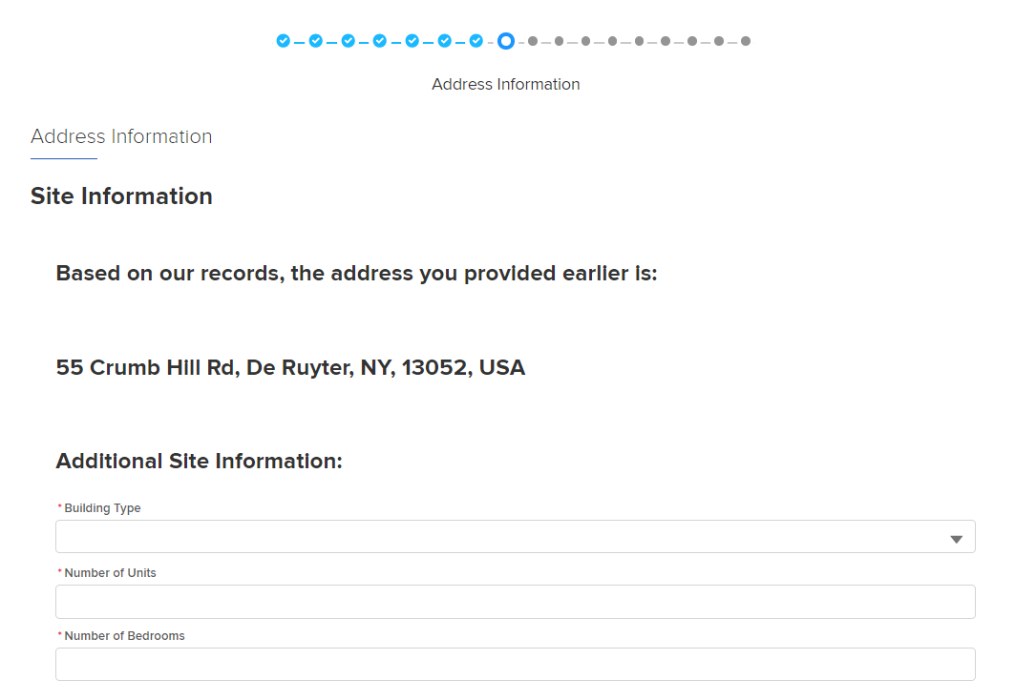
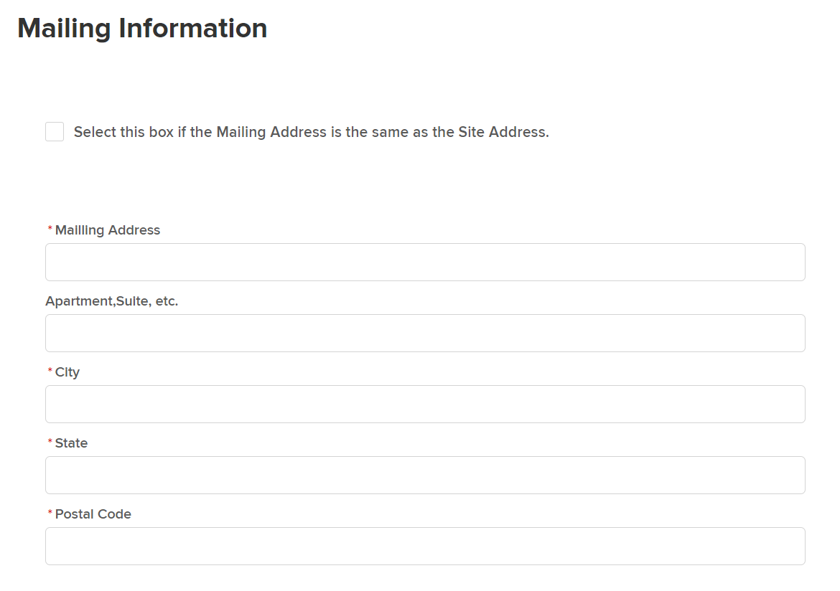
How to Submit an Application?
Application management
Step 11. Confirm Site Information and Click Next
Updating Addresses:
If the listed Mailing Information is the same as listed, select the box. If it is not, update the mailing address below
Notes:
Your address will auto populate from the pre application you filled out early.
You can select from the building type either single family, or two four family, group home.
For single family you will not fill in units.
But for other programs you will fill out numbers of units and number of bedrooms in each unit.
You will check the box if mailing address is the same as the site address.

Slide 36
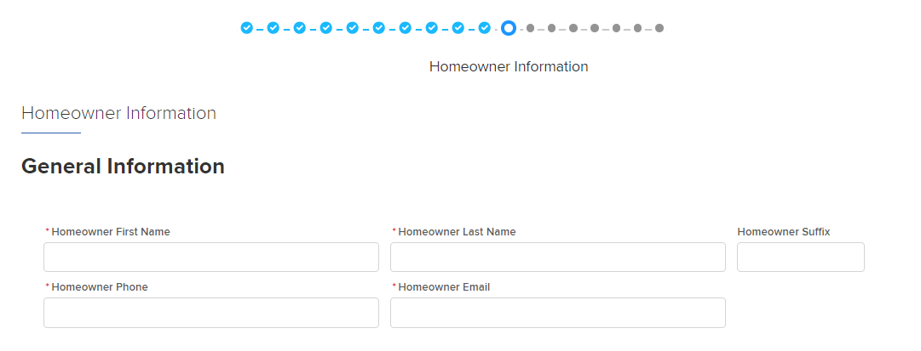
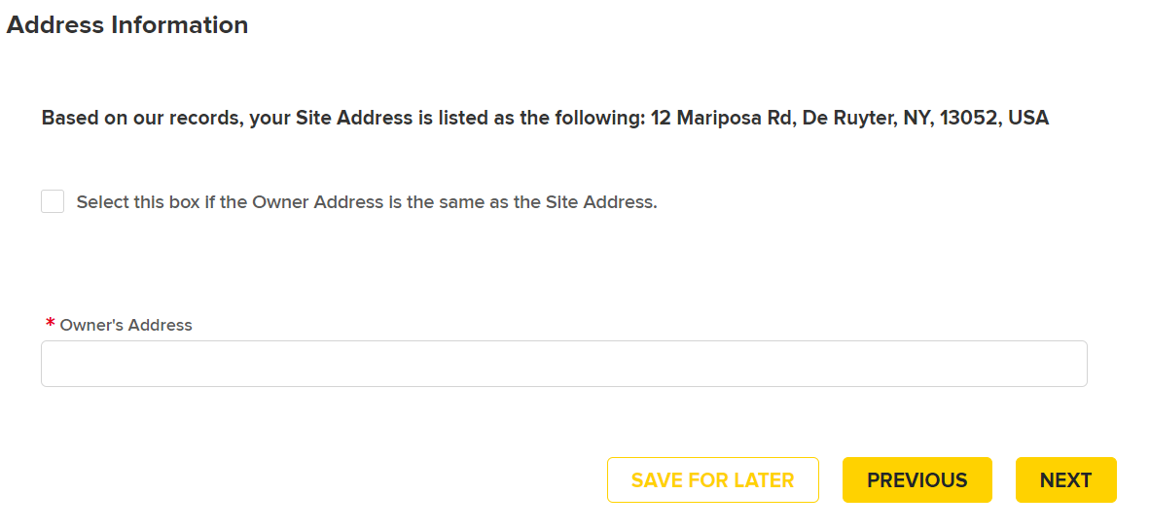
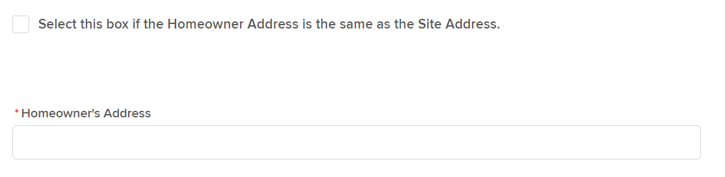
How to Submit an Application?
Application management
Step 12. Enter Homeowner Information and Click Next
Updating Addresses:
If the listed Site Address listed is the same as the homeowner’s address, select the box. If they are different, enter the address below
Notes:
This is effectively just information just about the homeowner/landlord.

Slide 37
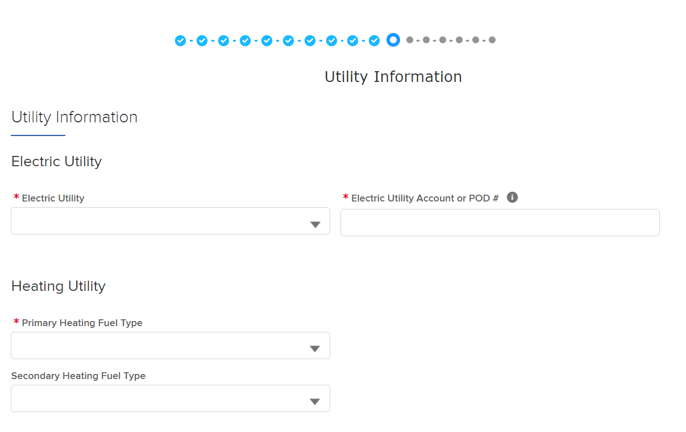

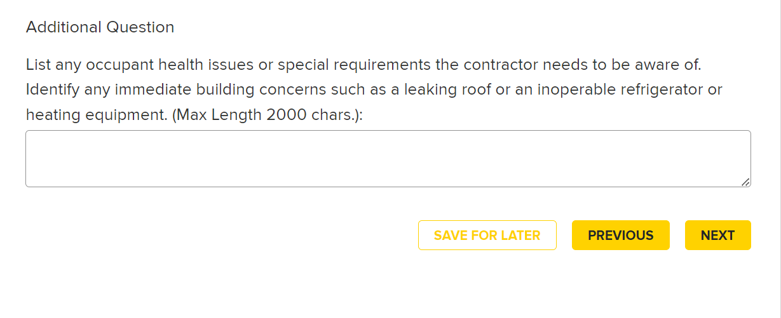
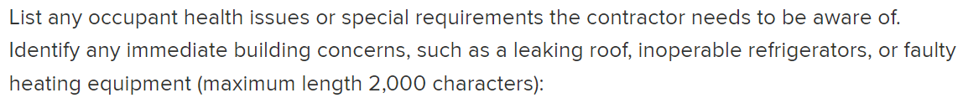
How to Submit an Application?
Application management
Step 13. Enter Utility Information and Click Next
Adding Special Requirements:
Under Utility Information, add any occupant health issues or special requirements a contractor needs to be aware of if applicable
Notes:
Then will fill out current information about the utility provider.

Slide 38
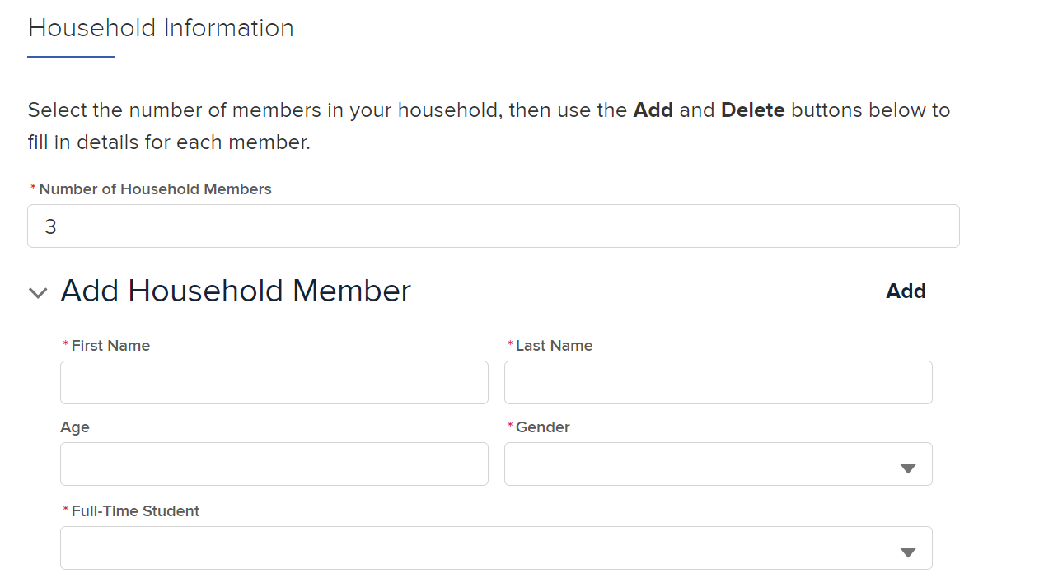
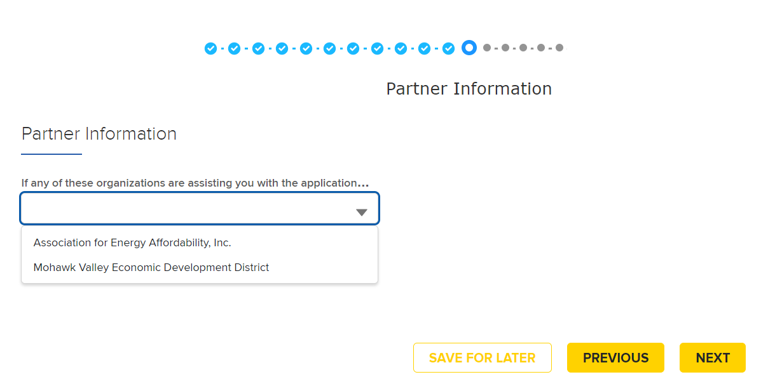
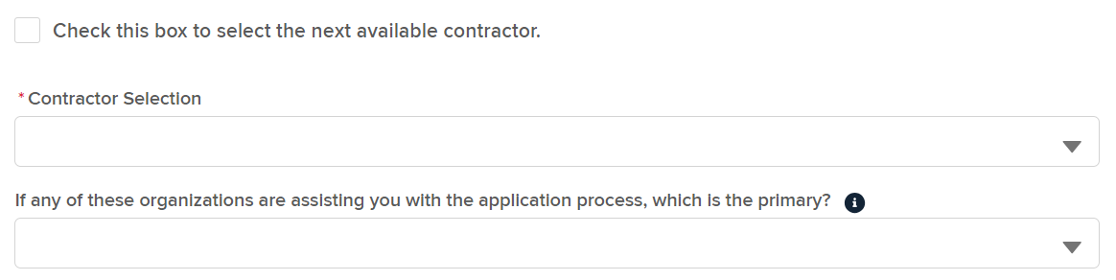
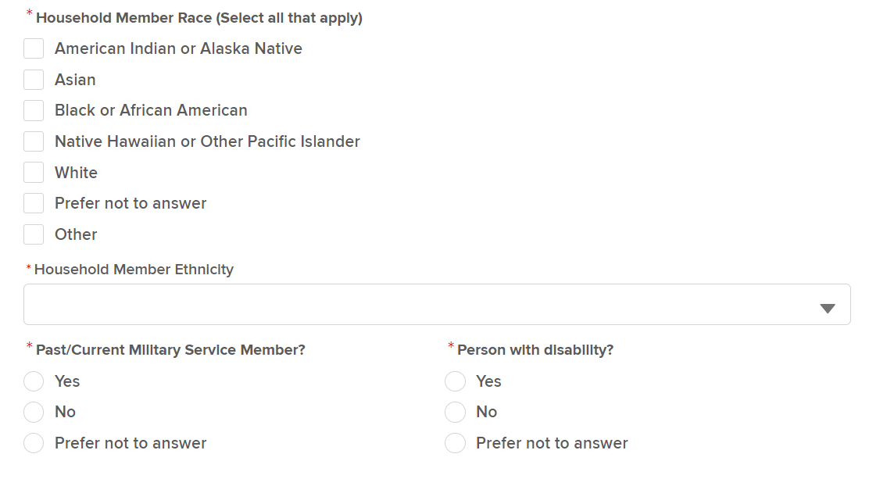

How to Submit an Application?
Application management
Step 14. Enter Partner Information and Click Next
Step 15. Enter Household Member Information and Click Next
Adding Household Members:
Under Household Information, Confirm the Number of Household Members and Enter Additional Details for each Household Member by Selecting Add.
Demographic Information will be required across AUP and EmP+ Programs.
Notes:
Either check the box to select the next available contractor or select from contractor selection where you will be able to filter by building type and building area to search for participating contractors.
The second optional question is asking if there is a hub assisting the customer with the application
Click
The number of household members will automatically be brought in from earlier in the application.
You need to add in household member demographic information. This is required across AUP and Empower + programs. We require contractors fill out this information for reporting. So that the programs report on the applications.
If you need time to gather the household member information you can always save and come back later and finish the application

Slide 39
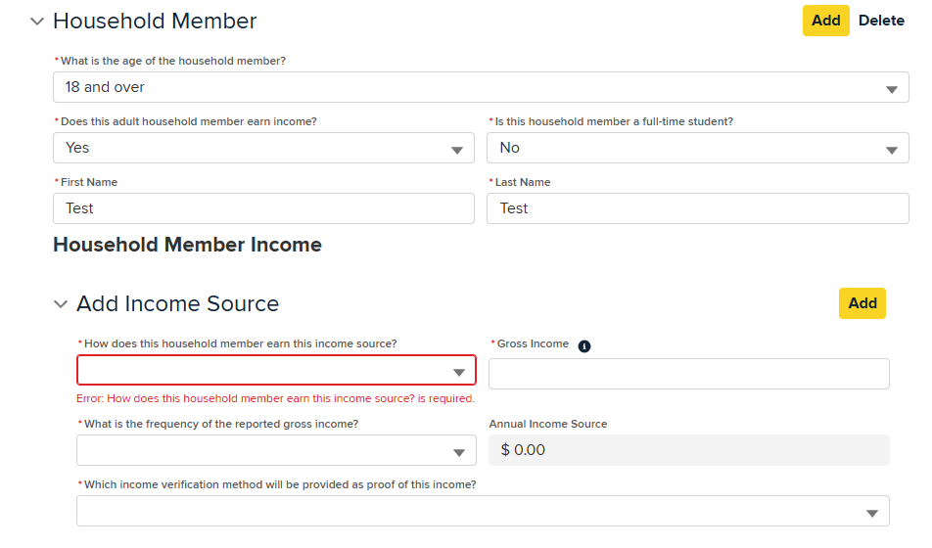
How to Submit an Application?
Application management
Step 16. If Applicable, Enter Household Member Income
Adding Household Member Income:
For applications where there is no award letter selected, income and income documentation will be required for household members who are:
18 years old or older or no age recorded, and
Not a Full-Time Student
  Adult Household Member with Income
Additional Information:
Annual Gross Income will be auto-calculated using the Gross Amount and Frequency inputted and the applicant will be prompted to upload the income verification method before submitting the application

Slide 40
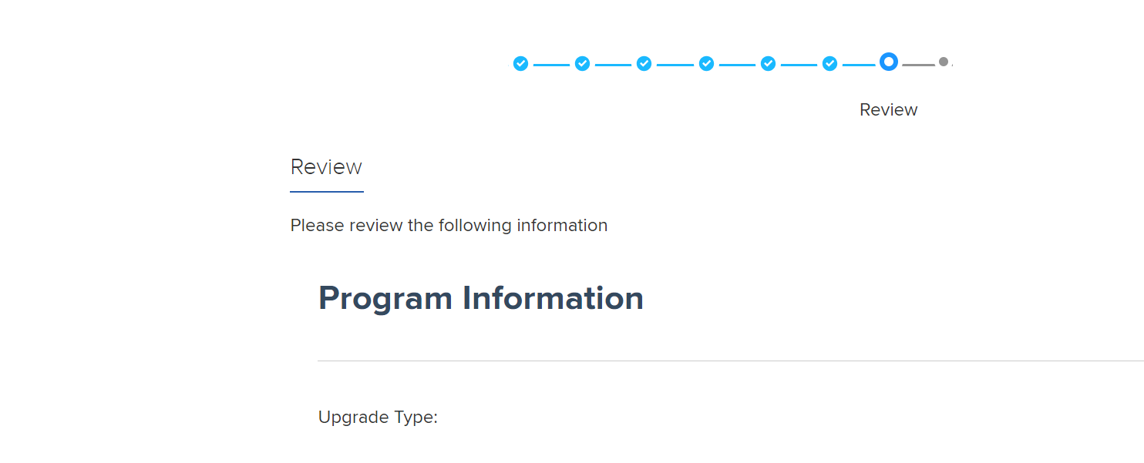
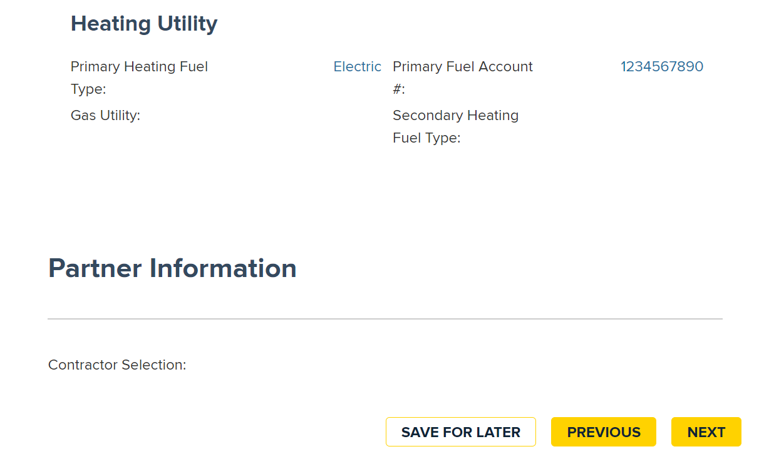
How to Submit an Application?
Application management
Step 17. Review all of the Information entered for this Application and Click Next
Application Review:
The following information entered will need to be verified before clicking Next
Applicant Information
Program Information
Address Information
Award Letter and Referral Information
Household Information
Household Income Information
Renter Information*
Homeowner Information*
Utility Information
Partner Information
* This information will display based on whether the applicant is a Homeowner or Renter, or applying on behalf of one
Notes:
This review page will should all of the information inputted into the application. Please go through and make sure all the information is accurate.

Slide 41
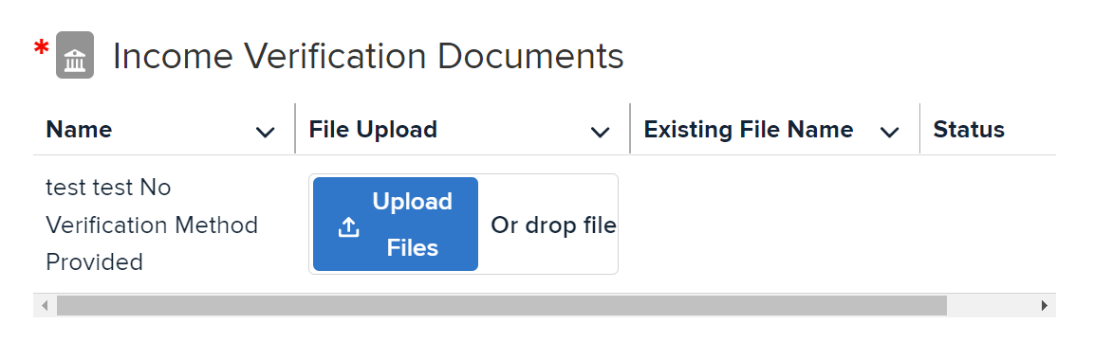

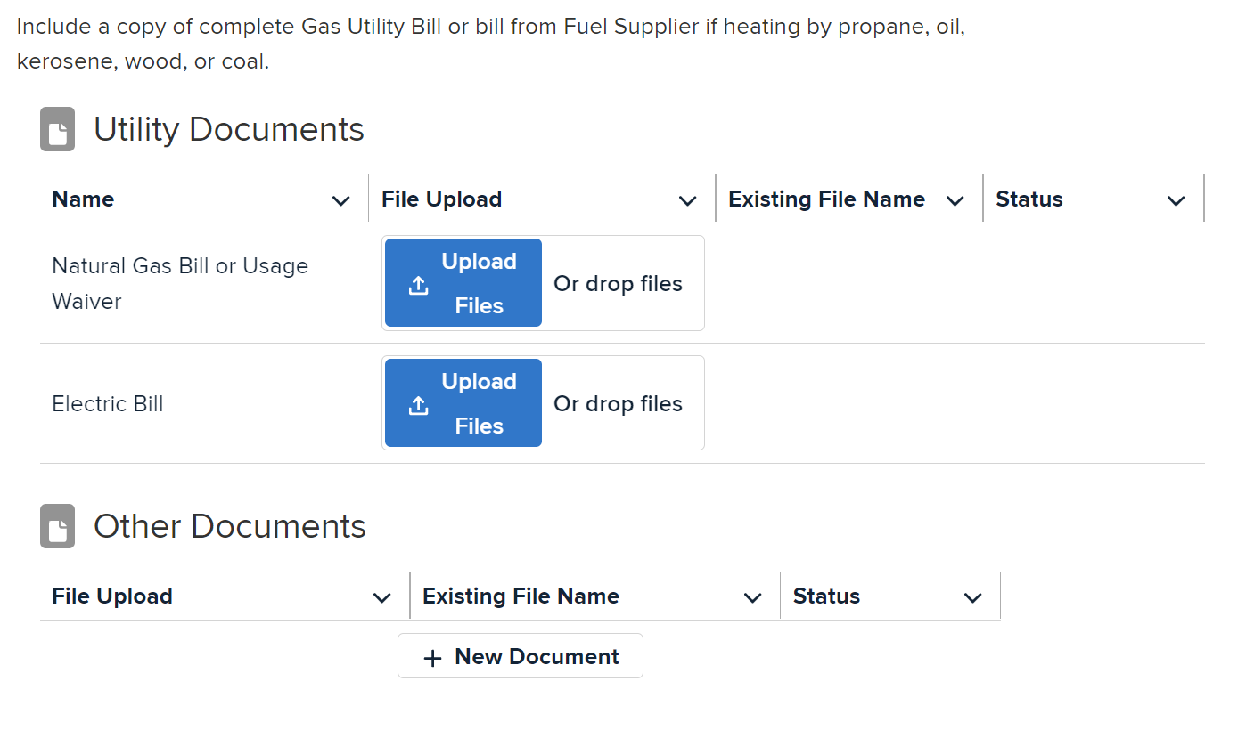

How to Submit an Application?
Application management
Step 18. Click Upload Files to upload required documentation and Click Next
What Documents should I upload?:
Categorical Income Information or Proof of Income
Natural Gas bill or Usage Waiver
Electric Bill
Notes:
Here for income verification, you will upload files like paystubs. Alternatively for the categorical eligibility route, you would have to upload the SNAP or TAN for other categorical eligibility.
Then for all applications you would upload gas and electric bills.
You could also upload other optional documents.

Slide 42
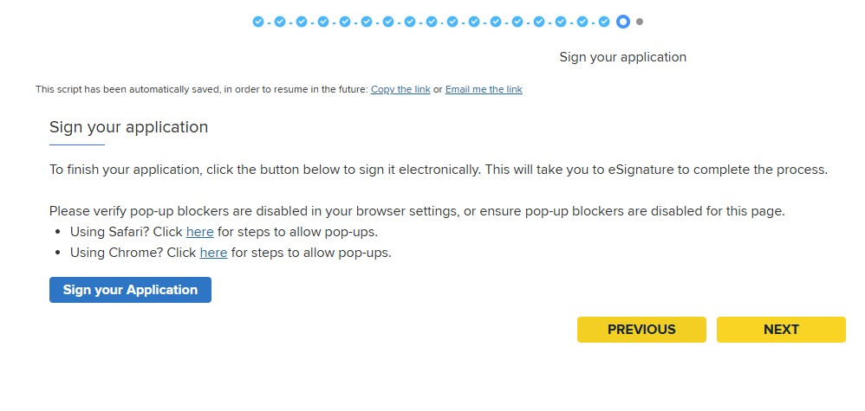
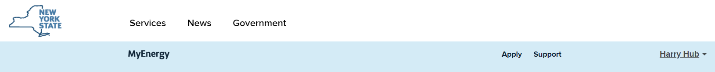

How to Submit an Application?
How to Submit an Application
Step 19. Click Next to download the application for customer signature. Note: Pop-up blockers may prevent users from downloading the pdf
Step 20. Click on the MyEnergy tile at the top of the page to return to the home page

Slide 43
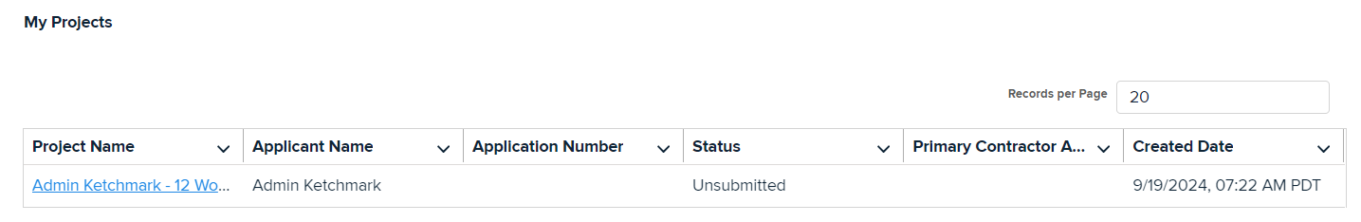
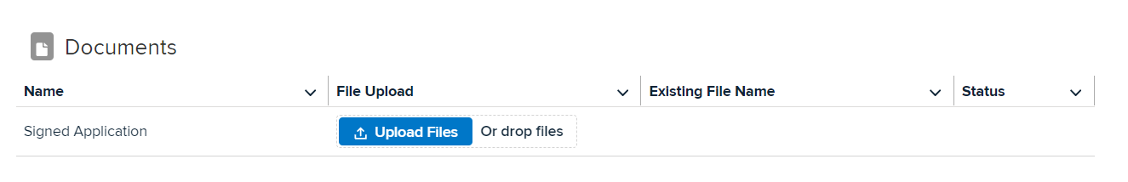

How to Submit an Application?
How to Submit an Application
Step 21. Scroll to find the Unsubmitted project in the My Projects table and Click into the Project Name
Step 22. Click Upload Files to upload the Signed Application and confirm the document and project statuses are updated to Submitted
Notes:
You will click into the project name where you can then upload the signed application. Then you will see the status changes to submitted. And the application signed date will get stamped. That is the end of application submission.

Slide 44
How to View an Application

Slide 45


How to View an Application via MyEnergy?
Application management
Step 1. Open MyEnergy and Scroll to My Projects and Applications
Step 2. Open Application
Notes:
Go to the homepage and you will be signed in as a hub . You will scroll down until you see the in progress applications you will click the blue hyperlink and that will open up the applcication.

Slide 46
Program Management
(EmPower+ and AUP)
46

Slide 47
How to Search for Installation Contractors on the NYSERDA Website

Slide 48

How to Search for Installation Contractors on the NYSERDA Website?
Program management
Verified
Step 1. Open MyEnergy Home Page, Scroll down the Page, and Click Find a Contractor

Slide 49

How to Search for Installation Contractors on the NYSERDA Website?
Program management
Step 2. Scroll Down and Select Find a Contractor
Tips for Contractor Selection:
There are multiple options for Residential Programs for selecting Installation Contractors. Keep in mind location of the contractor and ensure their capabilities align with the with the scope of work being considered.
Installation Contractor Options:
Energy Solutions for Income Eligible Home
Improve Your Home’s Contractor
Appliance Upgrade Contractors

Slide 50

How to Search for Empower+ Installation Contractors on the NYSERDA Website?
Program management
Step 1. Search for a participating contractor by entering your (1) Zip Code or by entering the (2) Company’s Name

Slide 51


How to Search for Installation Contractors on NYSERDA Website?
Program management
2
Step 1. Search for a participating contractor by selecting your (1) County or by entering the (2) Company’s Name
1

Slide 52


How to Search for Appliance Upgrade Installation Contractors on NYSERDA Website?
Program management
Step 2. View Contractors

Slide 53
Go Live Date 8/1/2025
53

Slide 54
Thank you for participating in today’s MyEnergy End User Training!
54

